Slide 1
CAPTURING SOCIAL & BEHAVIORAL DOMAINS & MEASURES IN ELECTRONIC HEALTH RECORDS: PHASE 2
Nancy E. Adler, PhD William W. Stead, MD
Committee Co-Chair Committee Co-Chair
Committee on Recommended Social & Behavioral
Domains & Measures for Electronic Health Records (EHRs)
Board on Population Health and Public Health Practice

Slide 2
COMMITTEE MEMBERS
NANCY E. ADLER, PH.D. (Co-Chair) University of California, San Francisco
WILLIAM W. STEAD, M.D. (Co-Chair) Vanderbilt University
KIRSTEN BIBBINS-DOMINGO, PH.D., M.D. University of California, San Francisco
PATRICIA F. BRENNAN, R.N., PH.D. University of Wisconsin-Madison
ANA V. DIEZ-ROUX, M.D., PH.D., M.P.H.
Drexel University School of Public Health
CHRISTOPHER B. FORREST, M.D., PH.D.
University of Pennsylvania and Children's Hospital of Philadelphia
JAMES S. HOUSE, PH.D.
University of Michigan
GEORGE HRIPCSAK, M.D., M.S.
Columbia University
MITCHELL H. KATZ, M.D.
Department of Health, County of Los Angeles
ERIC B. LARSON, M.D., M.P.H., M.A.C.P.
Group Health Research Institute
KAREN MATTHEWS, PH.D.
University of Pittsburgh School of Medicine
DAVID A. ROSS, SC.D.
Public Health Informatics Institute The Task Force for Global Health
DAVID R. WILLIAMS, PH.D., M.P.H. Harvard School of Public Health
Study Fellow
DEIDRA CREWS, M.D., Sc.M., FASN
IOM Gilbert S. Omenn Anniversary Fellow
Johns Hopkins University School of Medicine
2

Slide 3
COMMITTEE charge
The committee was asked to:
Identify domains for consideration by ONC for Stage 3 meaningful use;
Determine criteria for selection;
Identify domains and measures for inclusion in all EHRs;
Consider implications of incorporating recommended measures into all EHRs; and
Identify Issues in linking other data systems.
3

Slide 4
TIMELINE
PHASE 2
PHASE 1
4

Slide 5
TIMELINE PHASE 1
PHASE 2
PHASE 1
2 Public workshops
Frameworks
Criteria
Candidate domain identification
Report Release: April 2014
5

Slide 6
CRITERIA PHASE 1
1
3
5
STRENGTH
USEFULNESS
RELIABLE &
VALID MEASURES
FEASIBILITY
SENSITIVITY
ACCESSIBILITY
2
4
6
6

Slide 7
USEFULNESS
INDIVIDUAL
POPULATION HEALTH
RESEARCH
7

Slide 8
CANDIDATE DOMAINS
SOCIODEMOGRAPHIC DOMAINS
Sexual orientation
Race/ethnicity
Country of origin/U.S. born or non-U.S. born
Education
Employment
Financial resource strain
(Food and housing insecurity)
BEHAVIORAL DOMAINS
Dietary patterns
Physical activity
Tobacco use and exposure
Alcohol use
INDIVIDUAL-LEVEL SOCIAL RELATIONSHIPS & LIVING CONDITIONS
Social connections and social isolation
Exposure to violence
PSYCHOLOGICAL DOMAINS
Health literacy
Stress
Negative mood and affect
(Depression, anxiety)
Psychological assets
(Conscientiousness, patient engagement/
activation, optimism, self-efficacy)
NEIGHBORHOODS & COMMUNITIES
Compositional characteristics
8

Slide 9
TIMELINE PHASE 2
PHASE 2
PHASE 1
Review of domain measures
Selection of parsimonious panel
9

Slide 10
CRITERIA PHASE 2
1
3
5
5
STRENGTH
USEFULNESS
RELIABLE &
VALID MEASURES
FEASIBILITY
SENSITIVITY
ACCESSIBILITY
6
2
4
6
10

Slide 11
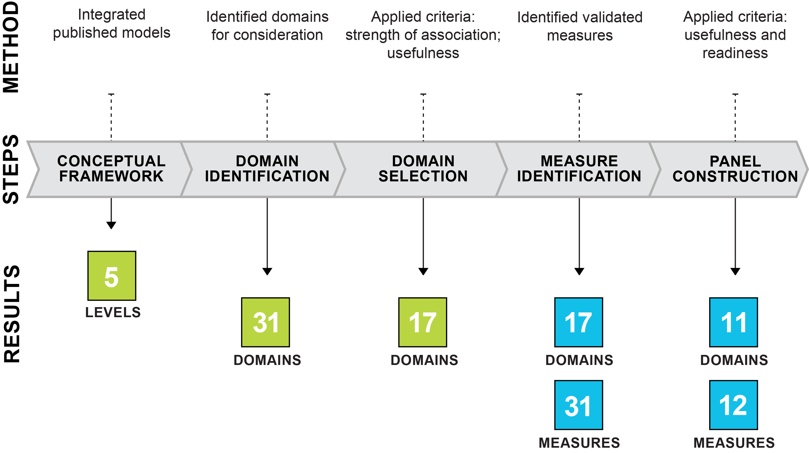
PROCESS
11

Slide 12
Standard Domain Measures
Self-Efficacy: NIH Toolbox (10 Q)
Race/Ethnicity: OMB (2 Q)
Optimism: LOT-R (6 Q)
Dietary Pattern: Fruit and Vegetable Consumption (2 Q)
Race/Ethnicity: U.S. Census (2 Q)
Education: Educational Attainment (2 Q)
Physical Activity: Exercise Vital Signs (2 Q)
Tobacco Use: NHIS (2 Q)
Social Connection and Isolation: NHANES III (4 Q)
Neighborhood and Community Compositional Characteristic: Residential address (1 Q)
3
Sex Orientation: Self identity (1 Q)
Health Literacy: Chew et al (2008) (3 Q)
Depression: PROMIS-8b (8 Q)
Employment: MESA (1 Q)
Financial Strain: Food Insufficiency (1 Q)
Anxiety: PROMIS-7a (7 Q)
Anxiety: GAD-7 (7 Q)
Conscientiousness: Big Five Inventory (1 Q)
Financial Strain: Overall Financial Resource Strain (1 Q)
Stress: Elo et al. (2003) (1 Q)
Depression: PHQ-2 (2 Q)
Alcohol Use: AUDIT-C (3 Q)
Neighborhood and Community Compositional Characteristic: Census Tract-Median Income
Readiness
2
Stress: ACE (11 Q)
Patient Engagement/ Activation: PAM
Self-Efficacy: Self-efficacy Scales for Specific Behaviors
Sex Orientation: Behavior (1 Q)
Country of Origin: U.S. Census (2 Q)
Financial Strain: Housing Insecurity (1 Q)
Physical Activity: Accelometer
Exposure to Violence: Intimate Partner Violence: HARK (4 Q)
1
1
2
3
Usefulness
Committee Judgment
1 = 2 = 3 =
NOTE: Bolded items are domains that are already frequently collected.
12

Slide 13
CORE DOMAINS & MEASURES WITH SUGGESTED FREQUENCY OF ASSESSMENT
DOMAIN/MEASURE | MEASURE | FREQUENCY
Alcohol Use Race and Ethnicity Residential Address Tobacco Use | 3 questions 2 questions 1 question (geocoded) 2 questions | Screen and follow up At entry Verify every visit Screen and follow up
Census Tract-Median Income Depression Education Financial Resource Strain Intimate Partner Violence Physical Activity Social Connections & Social Isolation Stress | 1 question (geocoded) 2 questions 2 questions 1 question 4 questions 2 questions 4 questions 1 question | Update on address change Screen and follow up At entry Screen and follow up Screen and follow up Screen and follow up Screen and follow up Screen and follow up
NOTE: Domains/Measures are listed in alphabetical order; domains/measures in the shaded area are currently frequently collected in clinical settings; domains/measures not in the shaded area are additional items not routinely collected in clinical settings.
13

Slide 14
FINDING
5-1
Four social and behavioral domains of health are already frequently collected in clinical settings. The value of this information would be increased if standard measures were used in capturing these data.
14

Slide 15
RECOMMENDATION
5-1
The Office of the National Coordinator for Health Information Technology and the Centers for Medicare & Medicaid Services should include in the certification and meaningful use regulations the standard measures recommended by this committee for four social and behavioral domains that are already regularly collected: race/ethnicity, tobacco use, alcohol use, and residential address.
15

Slide 16
FINDING
5-2
The addition of selected social and behavioral domains, together with the four domains that are already routinely collected, constitute a coherent panel that will provide valuable information on which to base problem identification, clinical diagnoses, treatment, outcomes assessment, and population health measurement.
16

Slide 17
RECOMMENDATION
5-2
The Office of the National Coordinator for Health Information Technology and the Centers for Medicare & Medicaid Services should include in the certification and meaningful use regulations addition of standard measures recommended by this committee for eight social and behavioral domains: educational attainment, financial resource strain, stress, depression, physical activity, social isolation, intimate partner violence (for women of reproductive age), and neighborhood median-household income.
17

Slide 18
BENEFITS
Benefits of including recommended measures in all EHRs include:
MORE EFFECTIVE TREATMENT
MORE EFFECTIVE POPULATION MANAGEMENT
DISCOVERY OF LINKAGES
18

Slide 19
IMPLEMENTATION ISSUES
SELF-REPORTED
DATA
LINKING DATA
PRIVACY PROTECTION
RESOURCE CONSIDERATIONS
19

Slide 20
FINDING
7-1
Standardized data collection and measurement are critical to facilitate use and exchange of information on social and behavioral determinants of health. Most of these data elements are experienced by an individual and are thus collected by self-report. Currently, EHR vendors and product developers lack harmonized standards to capture such domains and measures.
20

Slide 21
RECOMMENDATION
7-1
The Office of the National Coordinator for Health Information Technology’s electronic health record certification process should be expanded to include appraisal of a vendor or product’s ability to acquire, store, transmit, and download self-reported data germane to the social and behavioral determinants of health.
21

Slide 22
FINDING
7-2
The addition of social and behavioral data to EHRs will enable novel research. The impact of this research is likely to be greater if guided by federal prioritization activities.
22

Slide 23
RECOMMENDATION
7-2
The Office of the Director of the National Institutes of Health (NIH) should develop a plan for advancing research using social and behavioral determinants of health collected in electronic health records. The Office of Behavioral and Social Science Research should coordinate this plan, ensuring input across the many NIH institutes and centers.
23

Slide 24
FINDING
7-3
Advances in research in the coming years will likely provide new evidence of the usefulness and feasibility of collecting social and behavioral data beyond that which is now collected or which is recommended for addition by this committee. In addition, discoveries of interventions and treatments that address the social and behavioral determinants and their impact on health may point to the need for adding new domains and measures. There is no current process for making such judgments.
24

Slide 25
RECOMMENDATION
7-3
The Secretary of Health and Human Services should convene a task force within the next three years, and as needed thereafter, to review advances in the measurement of social and behavioral determinants of health and make recommendations for new standards and data elements for inclusion in electronic health records. Task force members should include representatives from the Office of the National Coordinator for Health Information Technology, the Center for Medicare and Medicaid Innovation, the Agency for Healthcare Research and Quality, the Patient-Centered Outcomes Research Institute, the National Institutes for Health, and research experts in social and behavioral science.
25

Slide 26
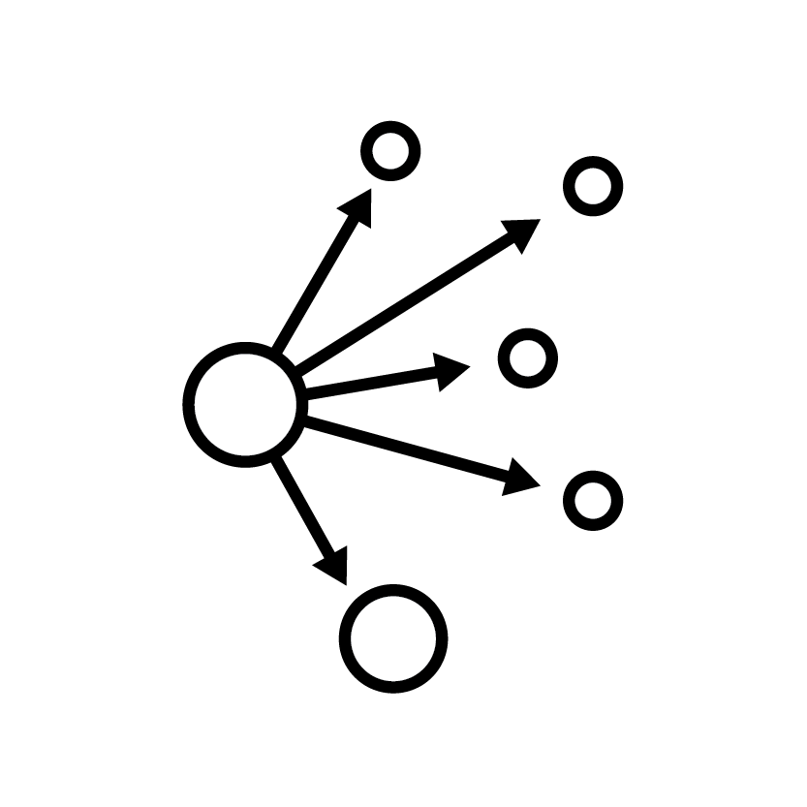
POTENTIAL NEXT STEPS
JOURNAL ARTICLES
REPORT DISSEMINATION
TOOL DEVELOPMENT
26

Slide 27
THANK YOU SPONSORS:
The National Institutes of Health
Blue Shield of California Foundation
California HealthCare Foundation
Centers for Disease Control and Prevention
Centers for Medicare & Medicaid Services
The Department of Veterans Affairs
The Lisa and John Pritzker Family Fund
Robert Wood Johnson Foundation
Substance Abuse and Mental Health Services Administration
27
Board on Population Health and Public Health Practice

Slide 28
Questions
The Full Report is now available for free download at: iom.edu/ehrdomains2
28
Board on Population Health and Public Health Practice

Slide 29
Measure versus Metric Example: Physical activity
Measure | Metric
Exercise Vital Sign | Metabolic equivalent task minutes (METs)
On average, how many days per week do you engage in moderate to strenuous exercise? (0-7) On average, how many minutes do you engage in exercise at this level (blocks of 10 min) | Light intensity 1.1-2.9 Moderate intensity 3.0-5.9 Vigorous intensity >=6
29

Slide 30
Standard Measure Example: Tobacco Use
Recommended self reported measure | Stage 2 measure
NHIS Questions | SNOMED Codes
Have you smoked at least 100 cigarettes in your entire life? 2. Do you NOW smoke cigarettes every day, some days or not at all? | Current every day smoker Current some day smoker Former smoker Never smoker Smoker, current status unknown Unknown if ever smoked Heavy tobacco smoker Light tobacco smoker
30

