Slide 1
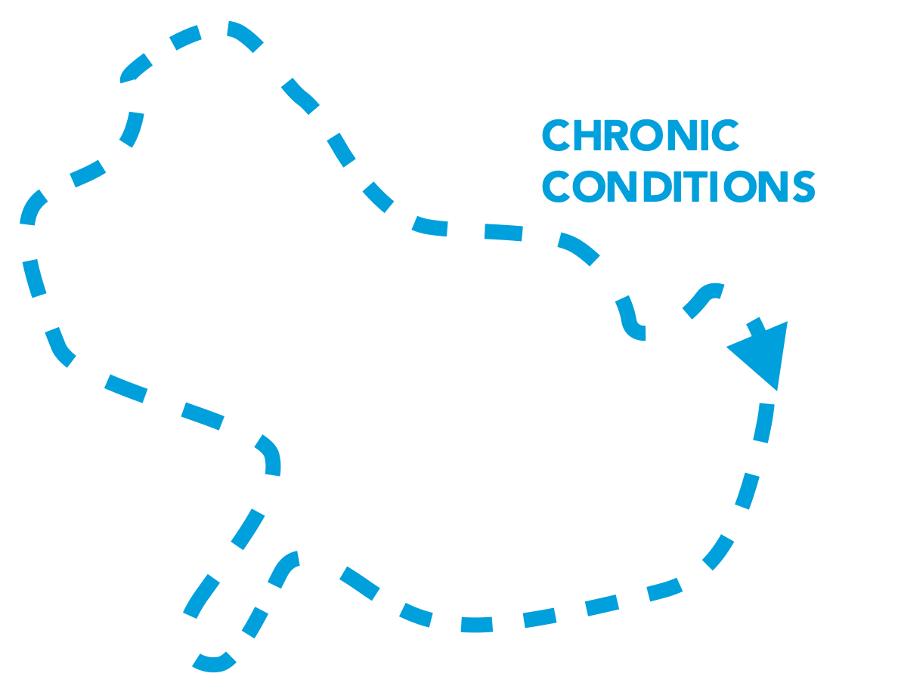
Stages of a Care Journey after TBI
RECOVERY AND
REINTEGRATION
Recovery of function to the greatest extent possible, including return to family, community, work, or school.
FOLLOW-UP
Continued engagement with the care system to identify and address ongoing and emerging needs, including provision of community-based support services.
For many, the journey is not continuous or smooth.
There can be bio-psycho-socio-ecological factors leading to:
A missed or delayed diagnosis
Difficulty accessing specialized care
Loss of access to care over time
Some people who experience chronic symptoms will need long-term services and supports.
CLASSIFICATION
Assessment of the nature and severity of a TBI to inform diagnosis, prognosis, and treatment. Includes reassessment as a person’s condition evolves.
REHABILITATION
Interventions aimed at improving a person’s physical, cognitive, and psychosocial functions and quality of life after a TBI.
ACUTE CARE
Medical interventions to stabilize a person’s health condition after a TBI, and to mitigate ongoing damage resulting from a TBI.
RECOGNITION
Awareness of the signs and symptoms of TBI, and the identification of an individual who needs care following a brain injury.

